Slide 1
Economics 144 Economic Forecasting
Lecture 12
VAR and IRF
Examples and Interpretation
Dr. Randall R. Rojas

Slide 2
Today’s Class
Two Examples of
Vector Autoregressions (VAR)
Predicative Causality (Granger-Causality)
Impulse-Response Functions (IRF)

Slide 3
VAR(p) Algorithm
Q: How to determine the order p of the VAR model?
Solution:
Start with p=1, compute VAR(1)
Continue with p=2, and keep the one with lowest AIC and BIC
Continue with p= 3, 4, …
After a certain value of p, AIC & BIC will worsen, therefore, decide on the model with lowest overall AIC and BIC.

Slide 4
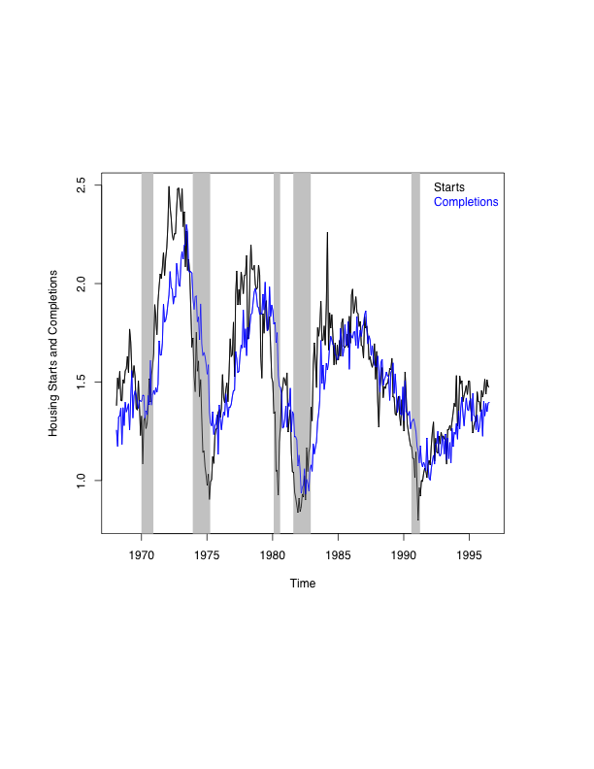
VAR Example 1 Housing Starts and Completions
Business Cycles
Expansion
Contraction

Slide 5
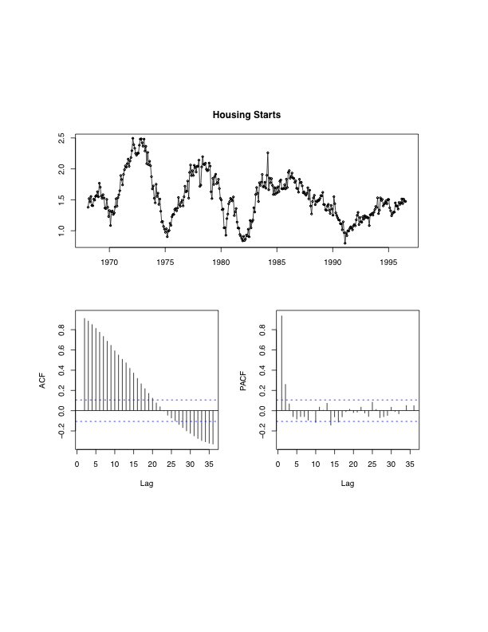
VAR Example 1 Housing Starts and Completions
PACF has a
Sharp cut off
at lag =2.
ACF → 0
(slowly)

Slide 6
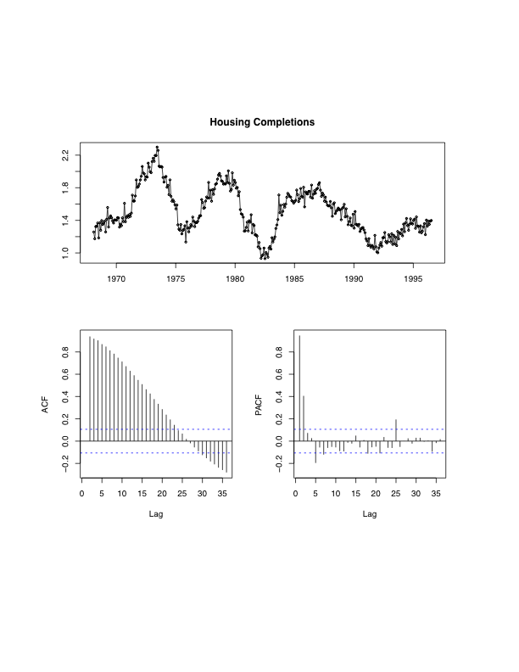
VAR Example 1 Housing Starts and Completions
PACF has a
Sharp cut off
at lag =2.
ACF → 0
(slowly)

Slide 7
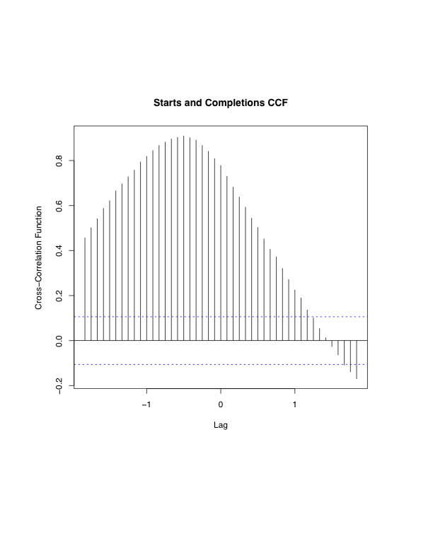
VAR Example 1 Housing Starts and Completions
Completions are maximally
correlated with starts
lagged by 6-12 months.
ρ_{CC} ≈ 0.90
Q: Do comps depend of starts,
or do starts depend on comps?
Def: Cross-Correlation
= ACF for the
multivariate case

Slide 8
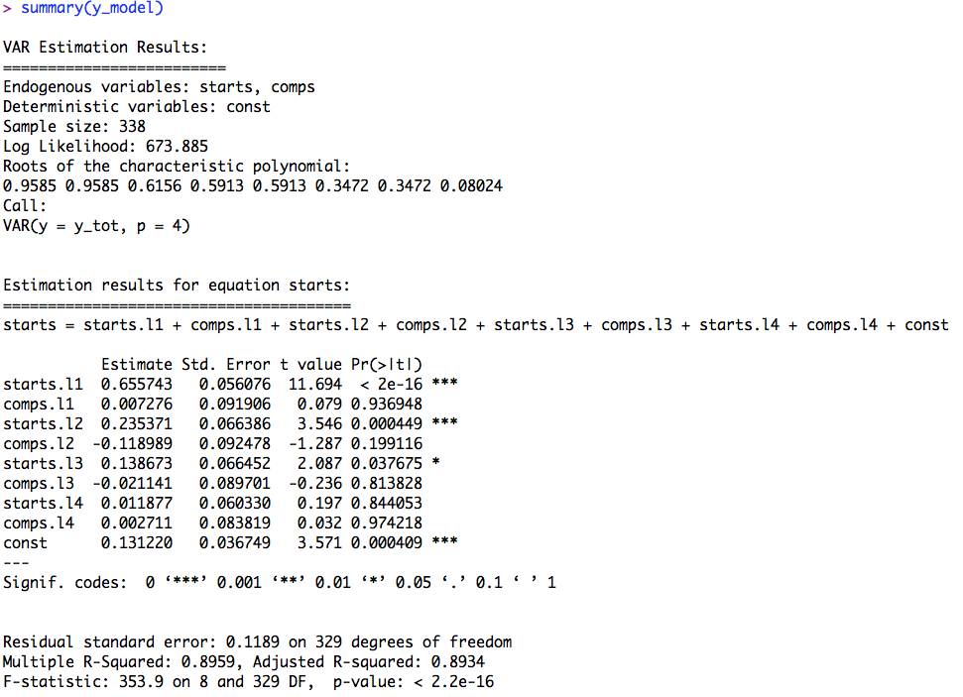
Regression Results
VAR(4) Model
Equation 1:
starts = c + starts_{t-k} + comps_{t-k}

Slide 9
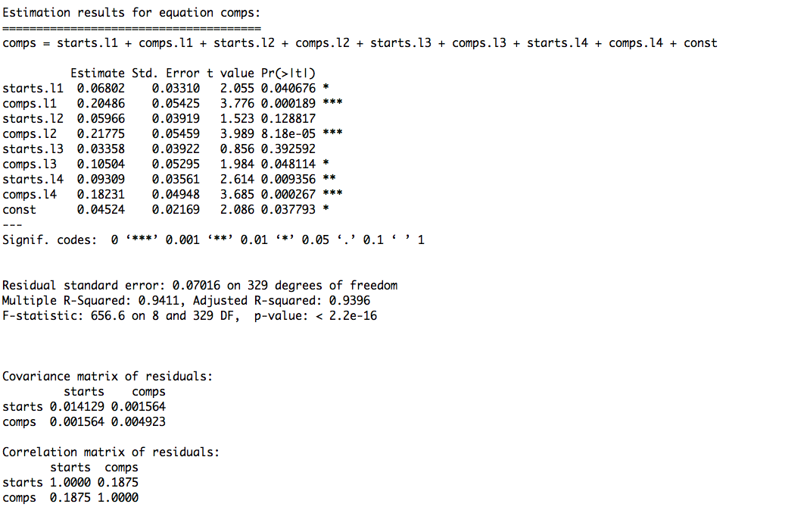
Regression Results
VAR(4) Model
Equation 2:
comps = c + starts_{t-k} + comps_{t-k}
A: It appears that
comps depend on starts
Ask R which one is it?

Slide 10
VAR Example 1 Housing Starts and Completions
Predicative Causality (Granger-Causality)
Q: Do comps ‘Granger-cause’ starts?
library(lmtest)
Grangertest(starts~comps,order=4)
Granger causality test
Model 1: starts ~ Lags(starts, 1:4) + Lags(comps, 1:4)
Model 2: starts ~ Lags(starts, 1:4)
Res.Df Df F Pr(>F)
1 329
2 333 -4 2.3066 0.05801 .
--
Signif. codes: 0 ‘***’ 0.001 ‘**’ 0.01 ‘*’ 0.05 ‘.’ 0.1 ‘ ’ 1
R commands
H₀: comps do not cause starts
A:Fail to reject H₀ →No!

Slide 11
VAR Example 1 Housing Starts and Completions
Predicative Causality (Granger-Causality)
Q: Do starts ‘Granger-cause’ completions?
library(lmtest)
grangertest(comps~starts,order=4)
Granger causality test
Model 1: comps ~ Lags(comps, 1:4) + Lags(starts, 1:4)
Model 2: comps ~ Lags(comps, 1:4)
Res.Df Df F Pr(>F)
1 329
2 333 -4 32.125 < 2.2e-16 ***
---
Signif. codes: 0 ‘***’ 0.001 ‘**’ 0.01 ‘*’ 0.05 ‘.’ 0.1 ‘ ’ 1
R commands
H₀: starts do not cause comps
A: Reject H₀→Yes!

Slide 12
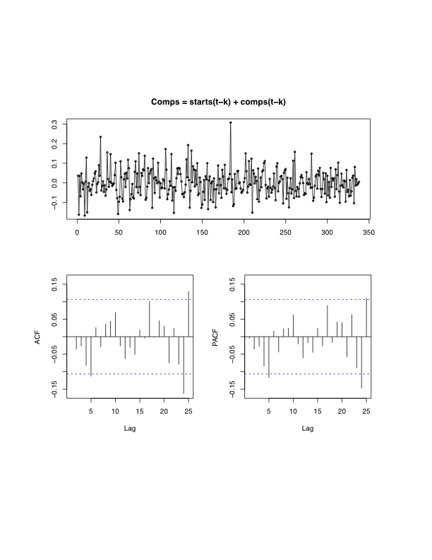
VAR Example 1 Housing Starts and Completions
Residuals
Residuals
ACF
Residuals
PACF

Slide 13
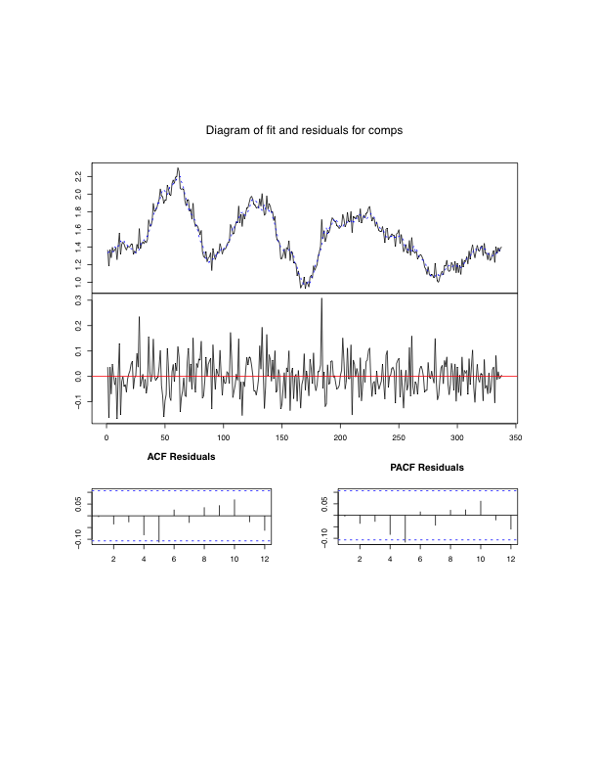
VAR Example 1 Housing Starts and Completions
-Completions
-Fit

Slide 14
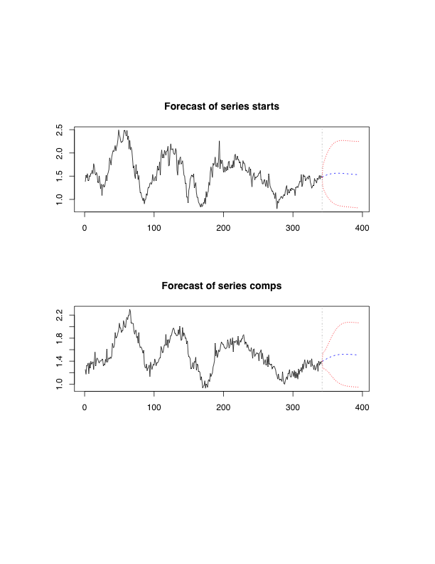
VAR Example 1 Housing Starts and Completions

Slide 15
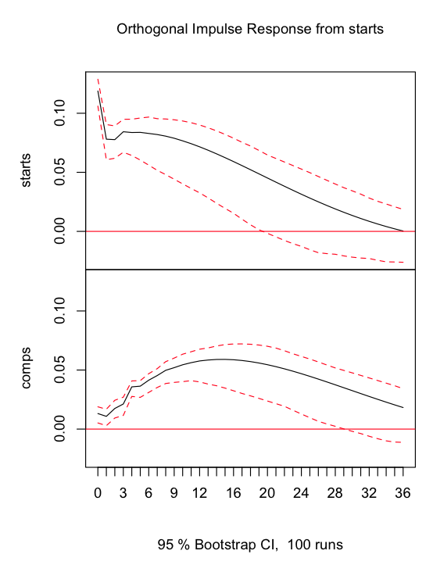
VAR Example 1 (IRF) Housing Starts and Completions
Effect of starts on starts
Own-Variable Impulse Response
Effect of starts’ shock on subsequent starts:
Initially a large effect but then decays slowly.
Effect of starts on comps
Cross-Variable Impulse Response
Effect of starts’ shock on subsequent comps:
Initially produces no movement, then
builds up, peaking around 14 months.

Slide 16
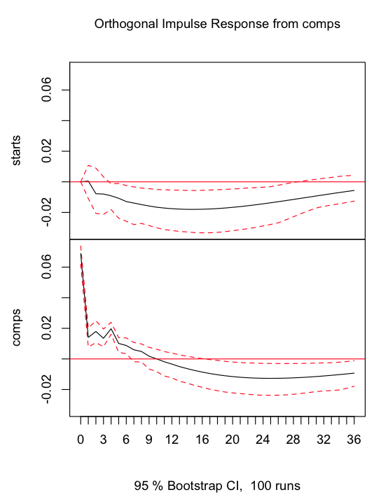
VAR Example 1 (IRF) Housing Starts and Completions
Effect of comps on starts
Cross-Variable Impulse Response
Effect of comps’ shock on subsequent starts:
Initially produces little movement in starts at all times.
Effect of comps on comps
Own-Variable Impulse Response
Effect of comps’ shock on subsequent comps:
Initially a large effect but then decays slowly.

Slide 17
VAR Example 2 House Price Growth in LA & Riverside
They move together
Does Riverside depend on LA or
does LA depend on Riverside?

Slide 18
VAR Example 2 House Price Growth in LA & Riverside
The two economies are linked via commuters
Increase in economic activity in LA
Increase in demand for housing in LA
LA housing prices go up
Demand for houses in Riverside go up
LA Economic Activity → Riverside Economic Activity
Riverside Economic Activity → LA Economic Activity ?

Slide 19
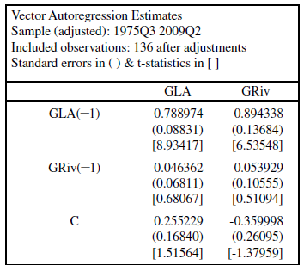
VAR Example 2 House Price Growth in LA & Riverside
Let Y = Los Angeles and X = Riverside
Try VAR(1) Model
Y_{t} = c₁+ α₁₁Y_{t-1}+β₁₁X_{t-1}+ε_{1t}
= 0.25+0.79Y_{t-1}+0.04X_{t-1}
X_{t} = c₂+ α₂₁Y_{t-1}+β₂₁X_{t-1}+ε_{2t}
= -0.36+0.89Y_{t-1}+0.05X_{t-1}
1% growth in LA →0.9% growth in Riverside

Slide 20
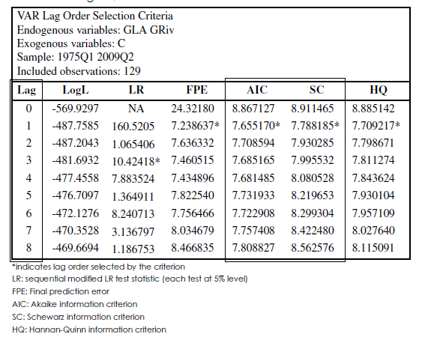
VAR Example 2 House Price Growth in LA & Riverside
Preferred Model = VAR(1)

Slide 21
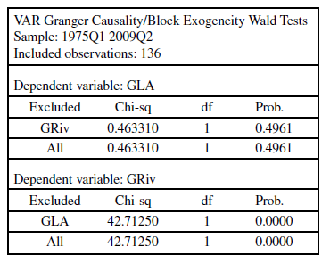
VAR Example 2 House Price Growth in LA & Riverside
Granger Causality Test
LA does Granger-Cause Riverside
H₀: Riverside has no effect on LA (β₁₁=0)
→ Fail to reject H₀
H₀: LA has no effect on Riverside (α₂₁=0)
→ Reject H₀
LA Market is useful in predicting the Riverside Market

Slide 22
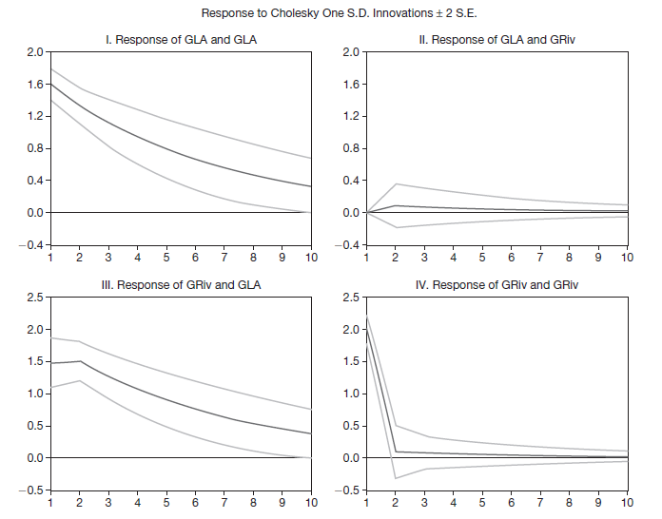
Impulse-Response Functions
LA market effect from a
shock in the Riverside market
Small
Riverside market effect from
a shock in the LA market
Large

Slide 23





Slide 24
VAR Example 2 House Price Growth in LA & Riverside

Slide 25
For Next Class
Readings about today’s class:
Chapter 11ª, 11^{b}
Review Exercises / Problems:
Chapter 11^{b}: 2, 3, 5, 6, 8
Readings for next class:
Chapter 12ª, 12^{b}

